Slide 1

Linux Network Defense Evasion (Part 2)
Aqeeb Hussain – Offensive Security Tactics For Linux Professionals

Slide 2
What’s New?
Current Methods Of Payload Delivery
Detection Considerations
Living Off The Land Tactics (LOTL)
Fileless Payload Delivery

Slide 3

Current Methods of Payload Delivery

Slide 4
Current methods
Payload downloaded remotely via HTTP(S) servers using wget, curl
Payload delivered via SCP (Subset of SSH)
Payload delivered via FTP
Payload delivered via RSYNC
Payload delivered via network socket using Python, Perl, Netcat
Notes:
There are many

Slide 5

What Do All Delivery Methods Have In Common?

Slide 6
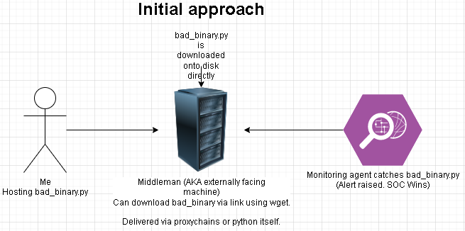

Slide 7

Detection Measures
HIDS (Host Intrusion Detection System) – Wazuh
SOC Analysts/Active Monitoring – Outsourced Contractors/In-house defenses
Scanning tools to detect unusual files (RKHunter)

Slide 8
Living Off The Land Tactics
Living off the land: Using available resources in the target environment to craft makeshift tools for exploitation.
Using built-in programming languages to create offensive scripts instead of using ready-made tools.
Using the targets environment against them in a minimalist manner to avoid detection.
You will always leave a trace behind, it’s just a case of how big/deep that trace is?
During LOTL tactics the scripts are dropped onto the disk leaving a bigger trace of attacker presence in the network.

Slide 9
How Do We OVERCOME This?

Slide 10
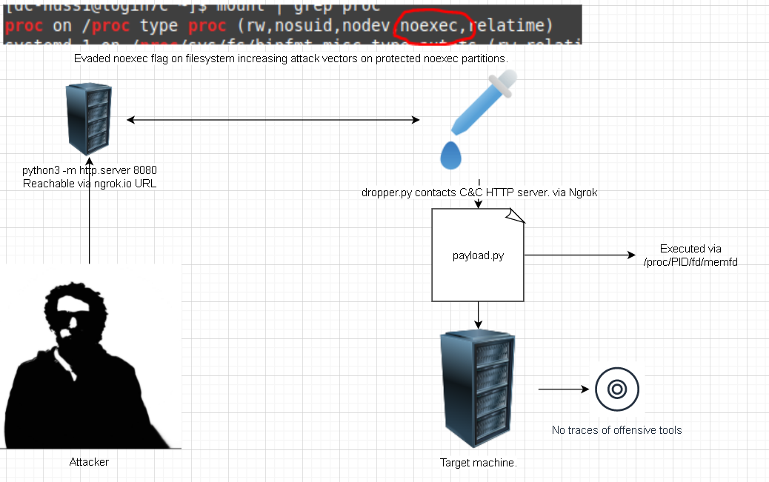
Fileless payload delivery

Slide 11
How Does Fileless Malware Delivery Work?
Fileless payloads are called via kernel system call known as: memfd_create()
Memfd_create as quoted from documentation is: “memfd_create() creates an anonymous file and returns a file descriptor that refers to it. The file behaves like a regular file, and so can be modified, truncated, memory-mapped, and so on. However, unlike a regular file, it lives in RAM and has a volatile backing storage. Once all references to the file are dropped, it is automatically released. Anonymous memory is used for all backing pages of the file.”

Slide 12
How Does Fileless Malware Delivery Work?
Fileless payloads can be called using any programming language and can use different methods such as:
Code packing – Packing a binary into an executable to deliver to the target using SSH pipes (Possible in Perl)
Hosting the payload via HTTP C&C payload

Slide 13
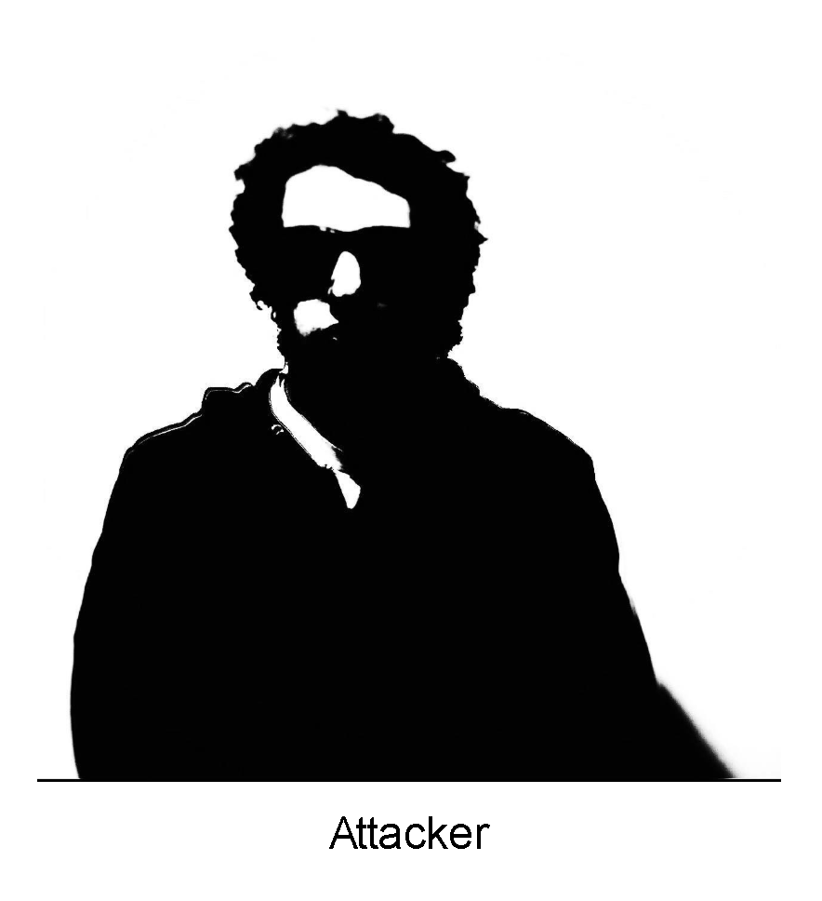
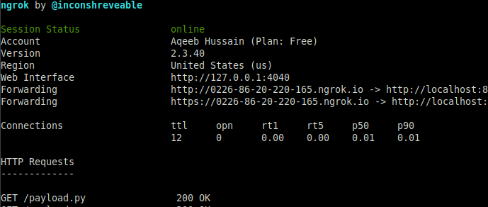
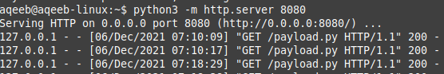
Implementation of Fileless Payload Delivery
Using C&C (Command & Control) machine which is used as the base operations we establish an HTTP server which will host the payload destined for target.
The method discussed will use NGROK to expose an HTTP server which the target can pull the payload from when execution is required.
payload.py
Exposing port 8080 via WAN using Ngrok

Slide 14
The Attack

Slide 15
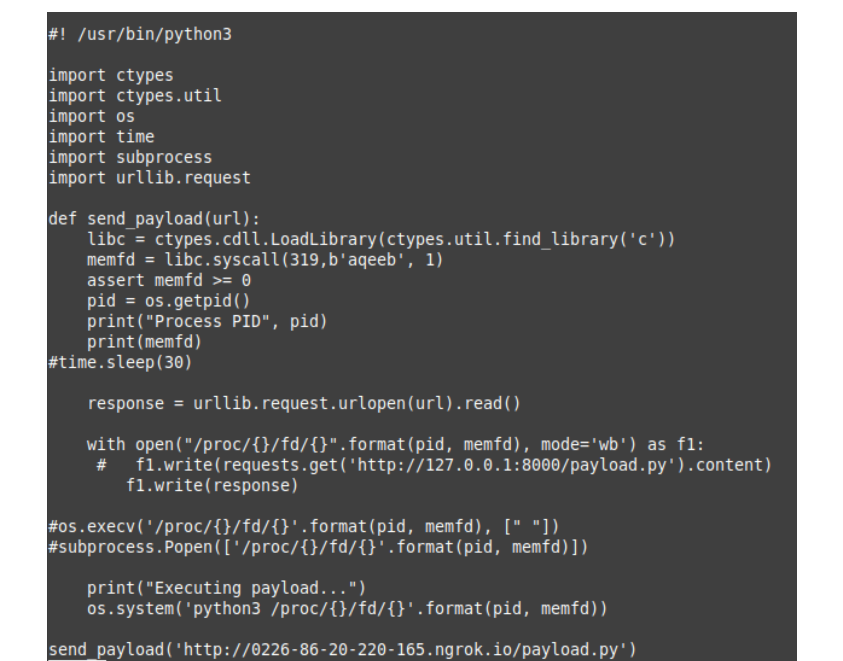
Dropper payload
Make a memfd syscall and create the file. We also grab the PID
URL pointing to the payload stored on HTTP C&C server
Read the payload data in bytes
Execute our payload (Python payload in this case)
Read the remote payload and write it to /proc with the memfd name and PID
Function call with ngrok based HTTP server containing payload.
15

Slide 16
Why use Fileless Payload Delivery?
Using malware dropper methods, HIDS/SOC systems cannot detect any malicious payloads on the target environment which would be left behind during regular LOTL practices of writing malicious scripts on target environment.
Can bypass “noexec” file systems which disallow execution of binaries on the partitions such as “/proc”
All traces of malware execution are erased upon reboot. If we are root, we could easily issue a reboot after cleaning tracks (Shredding relevant log traces/ leftover files)

Slide 17

What if the target is an internal host?

Slide 18
The Previous Attack?

Slide 19
Problems with our current approach
The ngrok server cannot be contacted from the edge since we want to send our payload directly to an internal machine.
We are not root, we can’t manipulate ip routes to get an internet connection.
We cannot directly contact the machine since the entry machine acts as a middleman.

Slide 20

What do we do now?

Slide 21
Solution: Offensive SSH
From attacker machine: “ssh -N -R 8080:localhost:8080 -J (middleman) (target)”
No command execution and remote port forwarding
Connect to the target host by first making a ssh connection to
the jump host described by destination and then establishing a TCP forwarding to the ultimate destination from there.
Local Python HTTP server on port 8080 is sent to internal machine on target network.

Slide 22
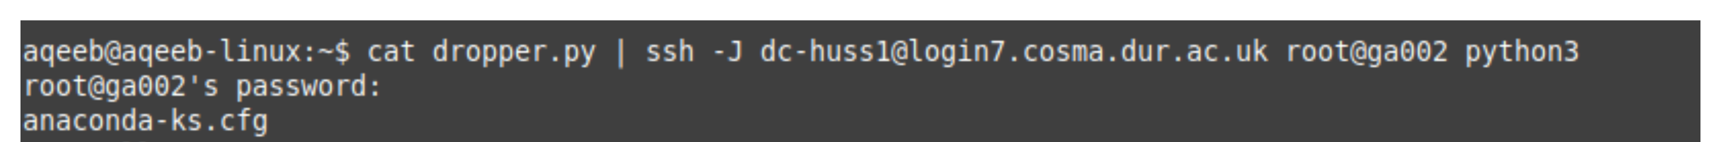
Contacting the internal target
We can’t drop any traces of our malware on the target disk
We can’t launch the dropper on the internal machine. This will defeat the objective of fileless payload delivery.
We make use of piping combined with SSH in order to deliver our dropper payload over SSH and execute it using the remote appropriate interpreter

Slide 23
Dropper payload (internal attack)
Payload will connect to an internally available server.
Change our IP to 127.0.0.1 since server will be tunnelled in via SSH

Slide 24
How do we protect ourselves as defenders?

Slide 25
How do we protect ourselves as defenders?
Fileless malware is an ALMOST invisible method of exploitation though it has drawbacks
Nothing may be dumped on the disk; however, we can detect malicious processes created in addition to using lsof
Attackers can take fileless malware by using droppers to integrate rootkits to hide network-based activity from native linux tools

Slide 26

Questions

Slide 27
THANK YOU
Instructor: Aqeeb Hussain
Email: aqeeb.r.hussain@durham.ac.uk
GitHub: https://github.com/aqeebhussain122/

